Slide 1

UNIVERSITY PROJECT – 2 HYRE – Higher You Reach Every time Group - 08

Slide 2
A PROJECT BY
Mr. Prajwal M S – 20171CSE0519
Mr. Prajwal P – 20171CSE0520
Mr. Pramukh N S – 20171CSE0524
Ms. Priyanka A – 20171CSE0536
Ms. Rachna Shah – 20171CSE0551
Under the guidance of
Mr. James Mathew P

Slide 3
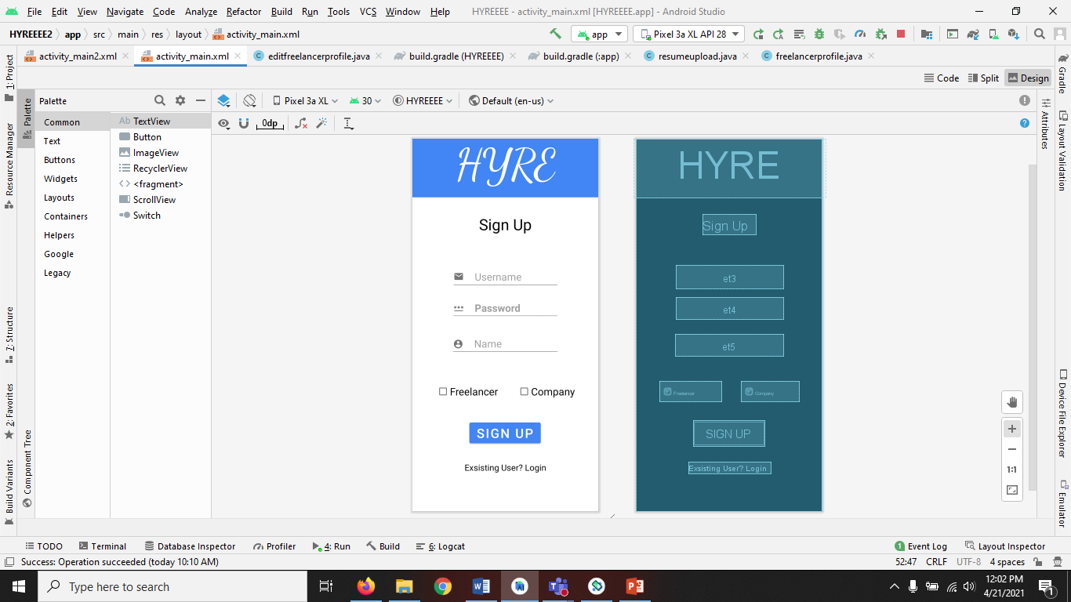
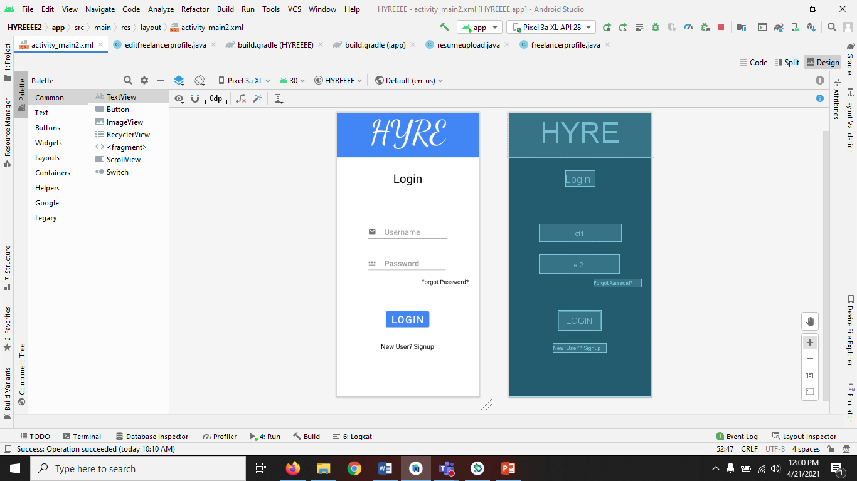
Module 1- Login And Signup
Sign up Page
Login Page

Slide 4
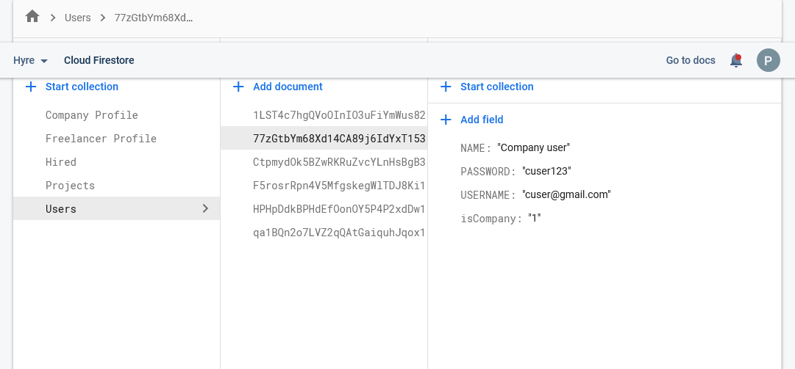
Signup Instances

Slide 5
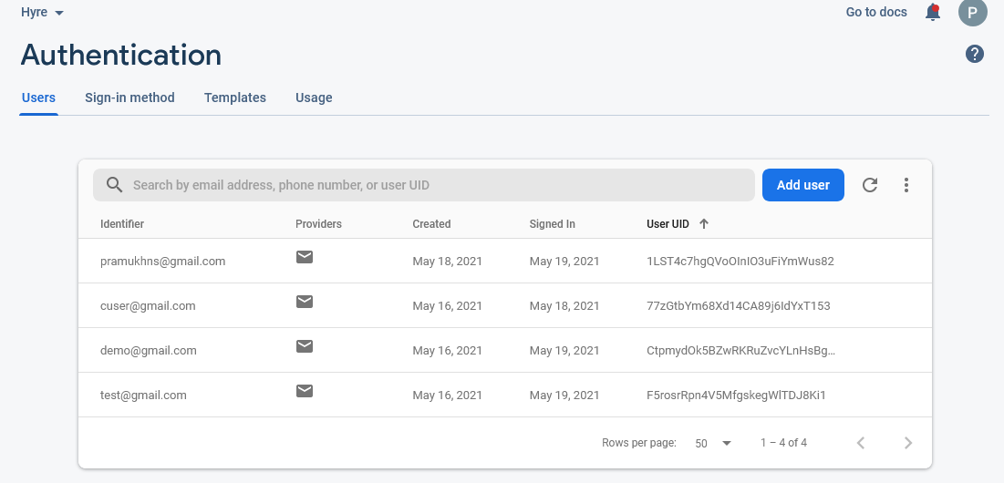
Login Instances

Slide 6
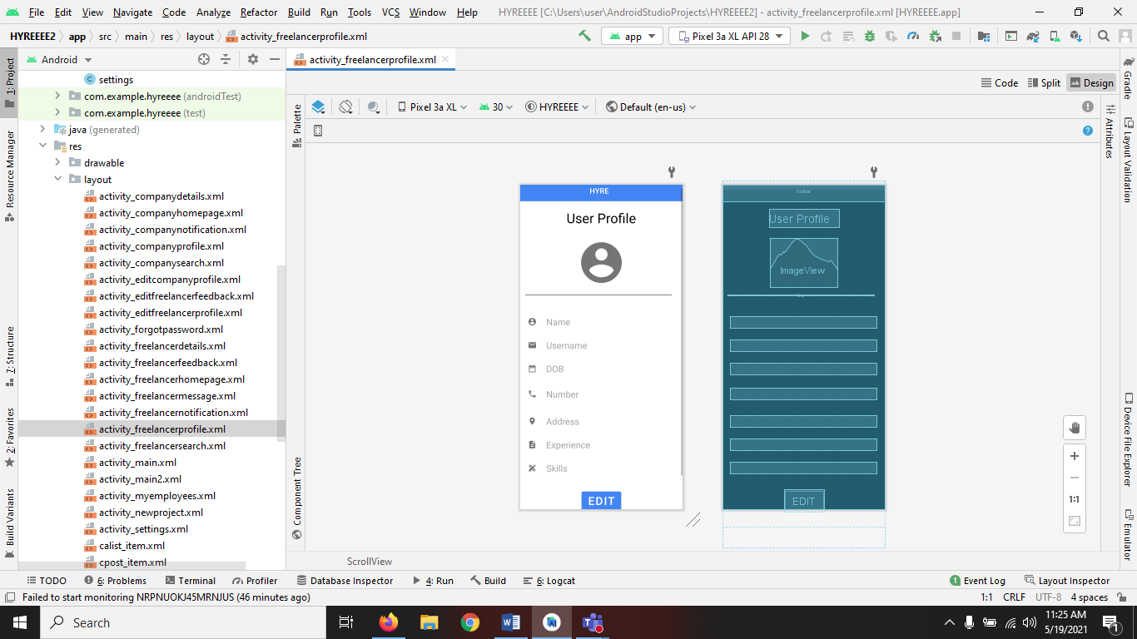
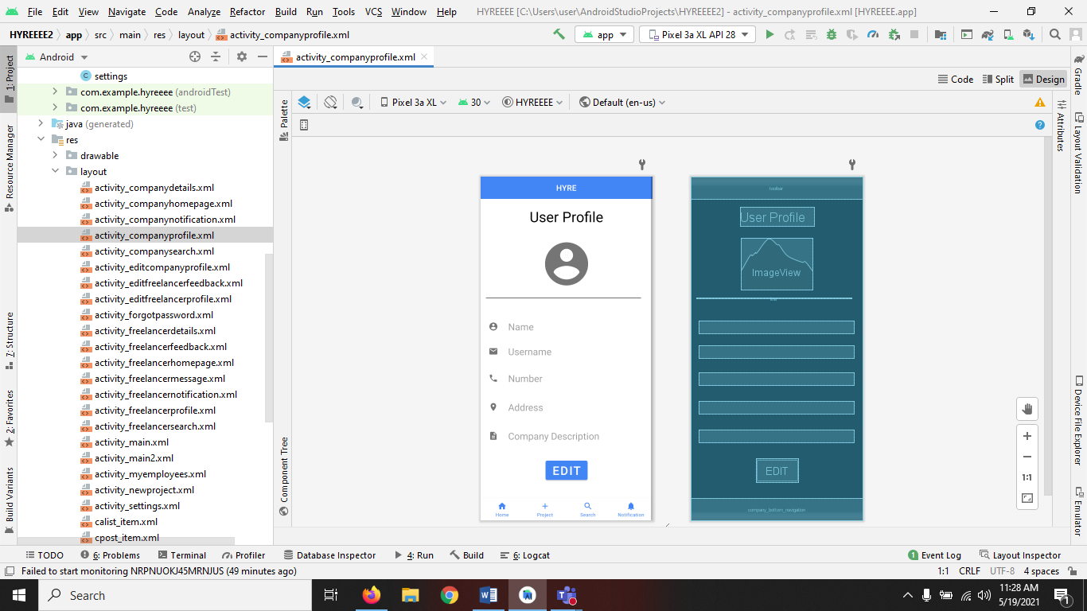
Module 2- Profile
Freelancer Profile
Company Profile

Slide 7
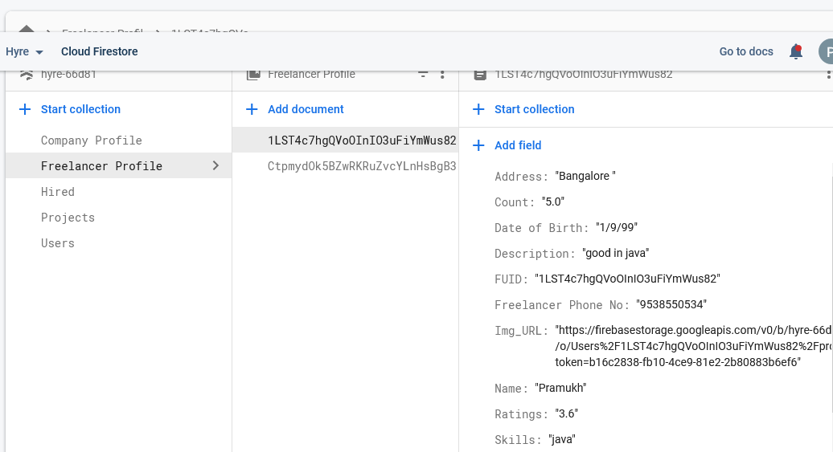
Freelancer Instances

Slide 8
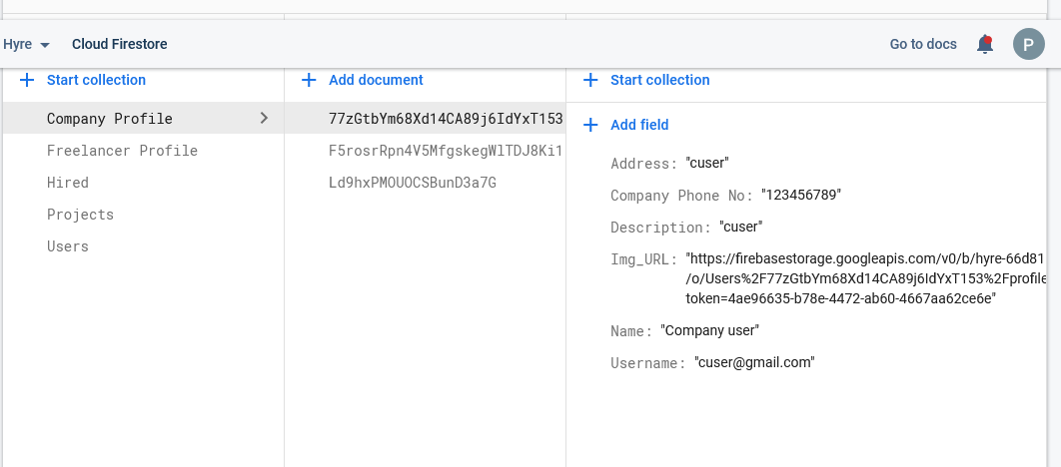
Company Instances

Slide 9
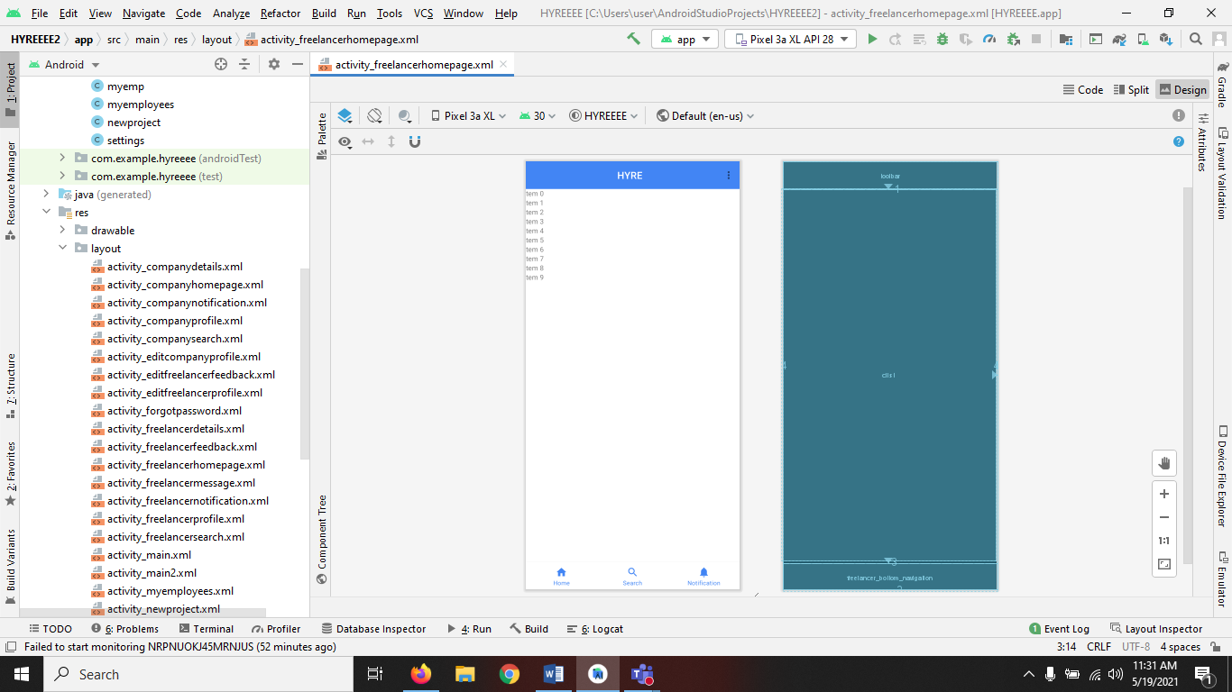
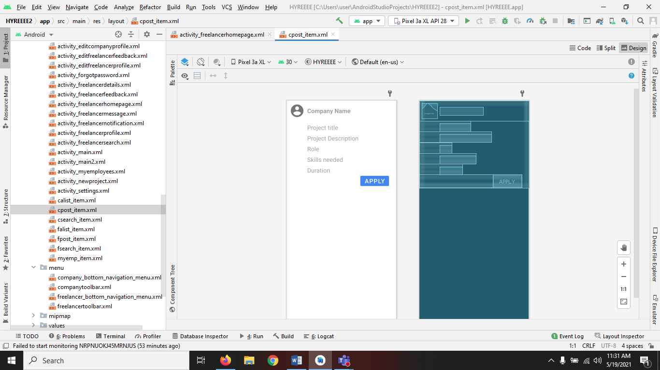
Module 3- Homepage

Slide 10
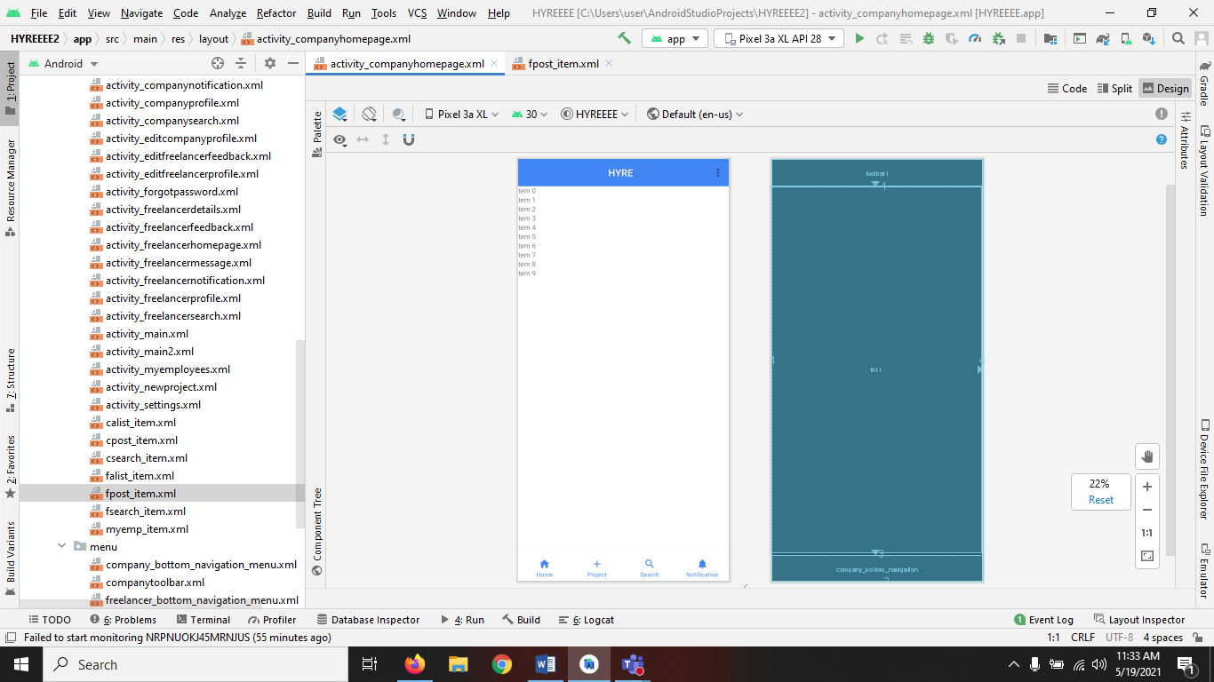
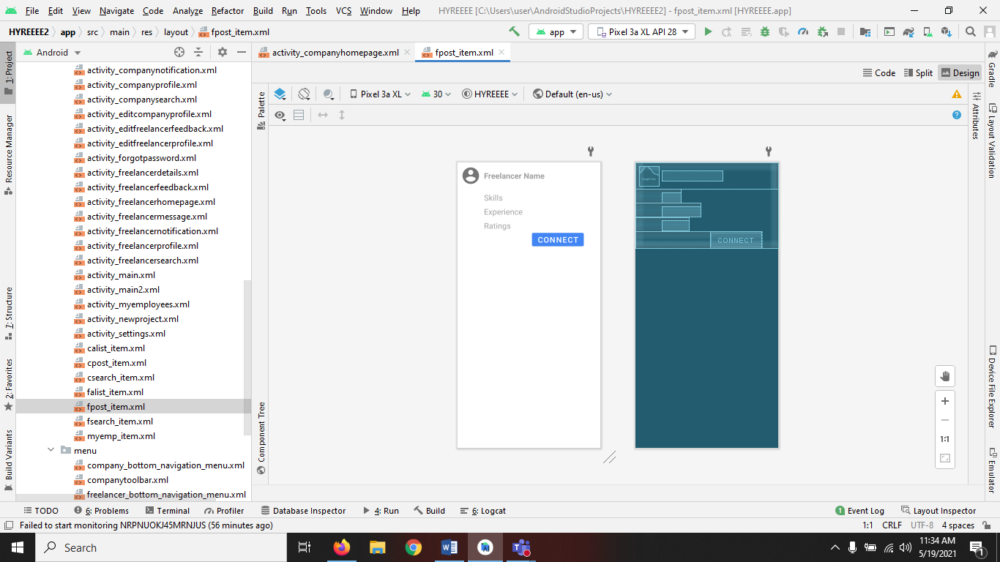
Company Homepage

Slide 11
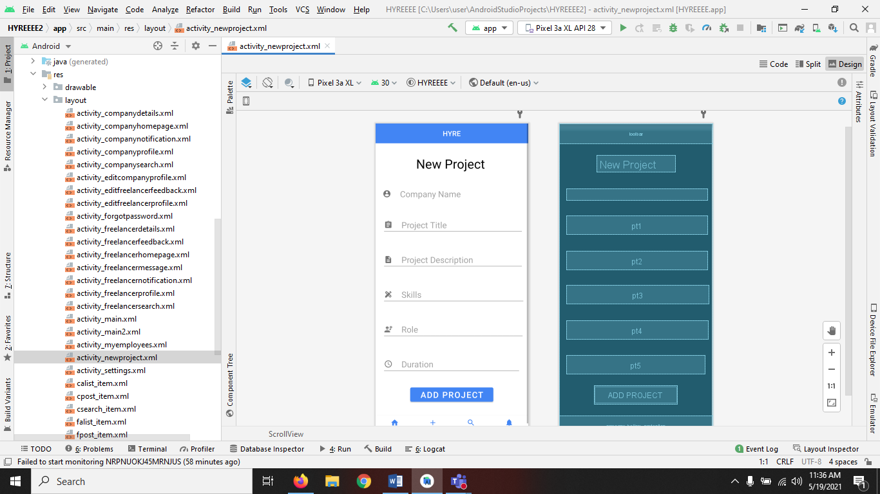
Module 4- New Project

Slide 12
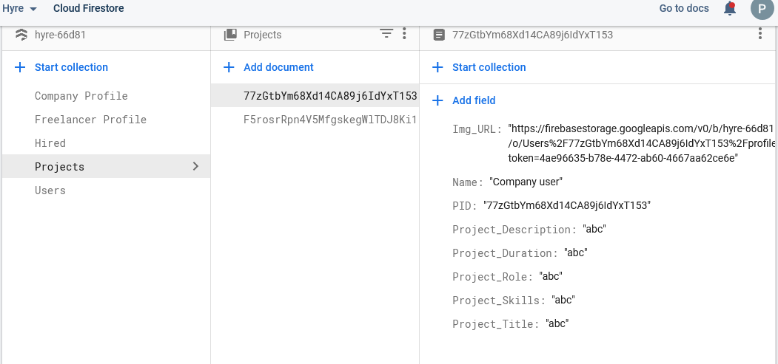
New Project Instances

Slide 13
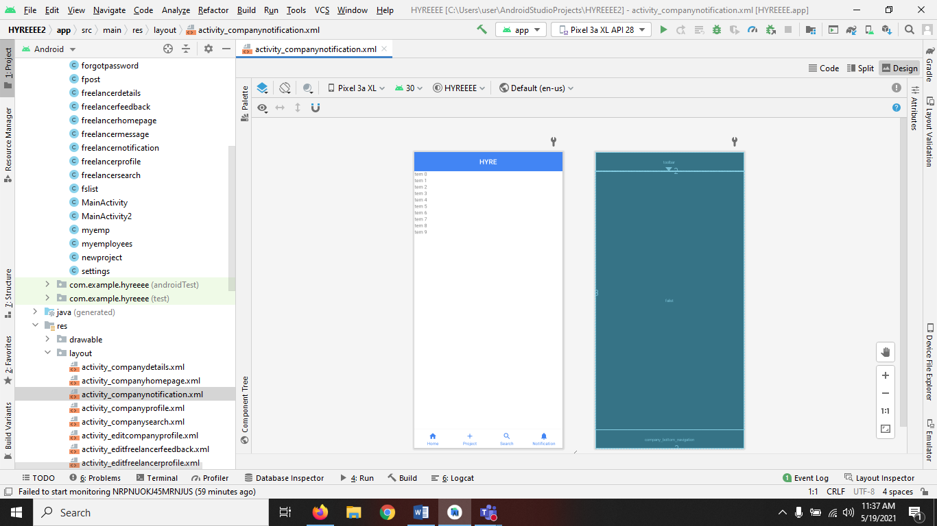
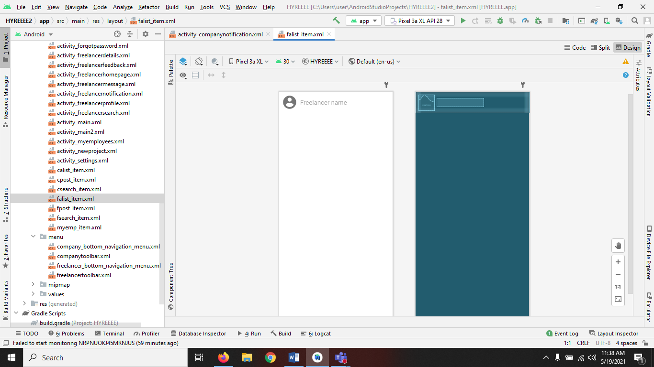
Module 5- Notification

Slide 14
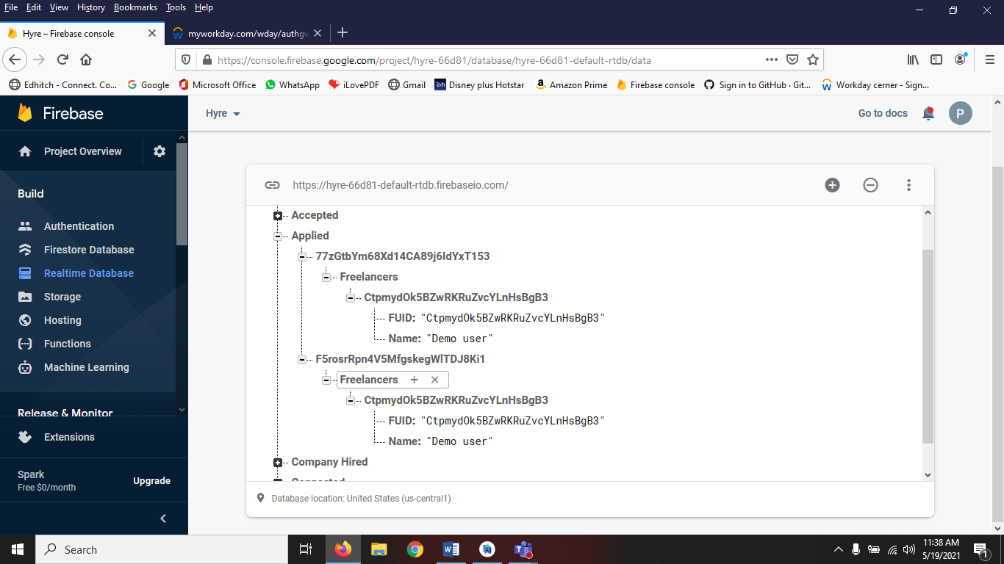
Notification Instances

Slide 15
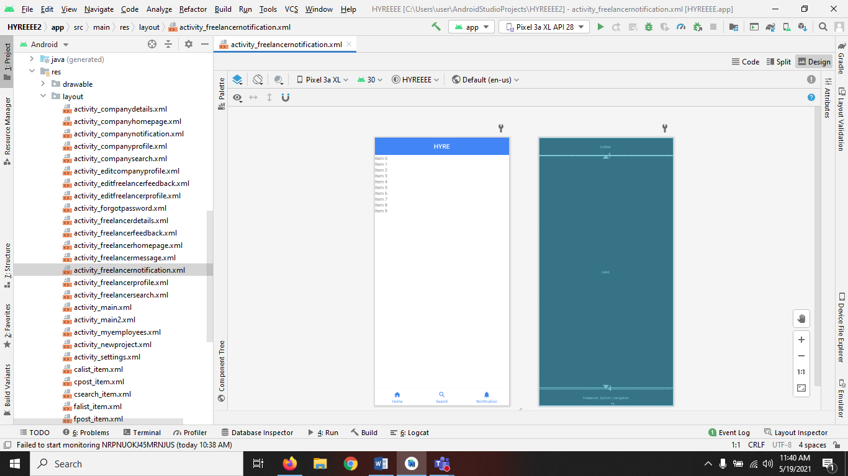
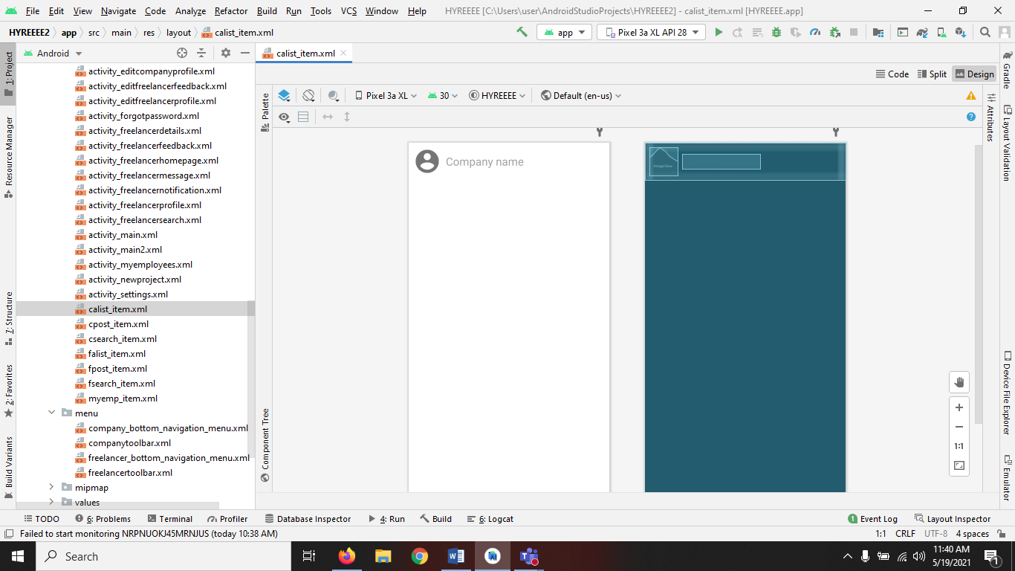
Freelancer Notification

Slide 16
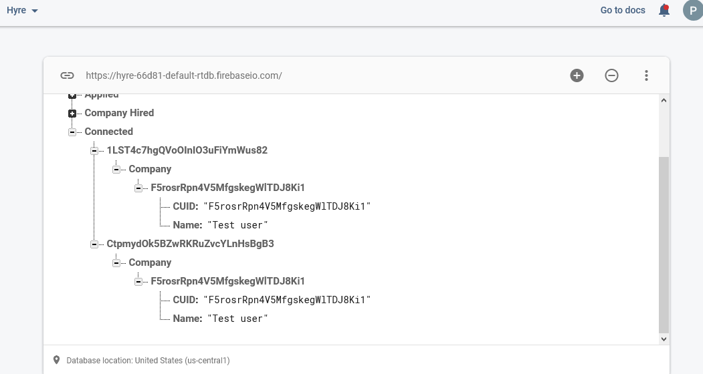
Freelancer Notification Instance

Slide 17
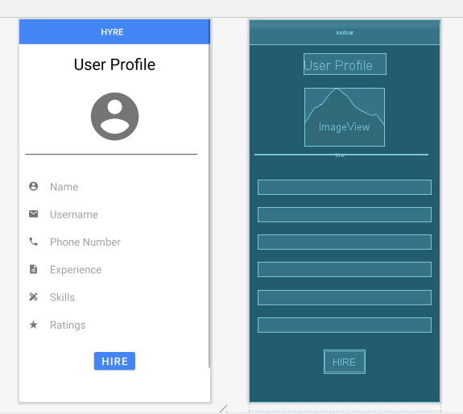
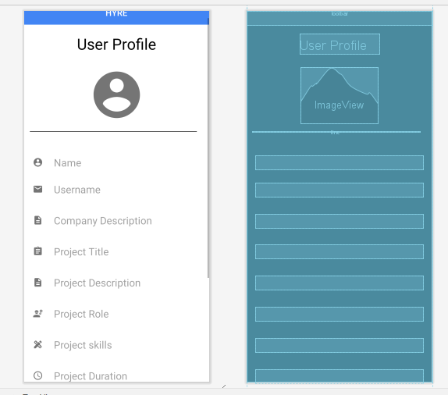
Module 6- Hire and Connection
Freelancer Details
Company Details

Slide 18
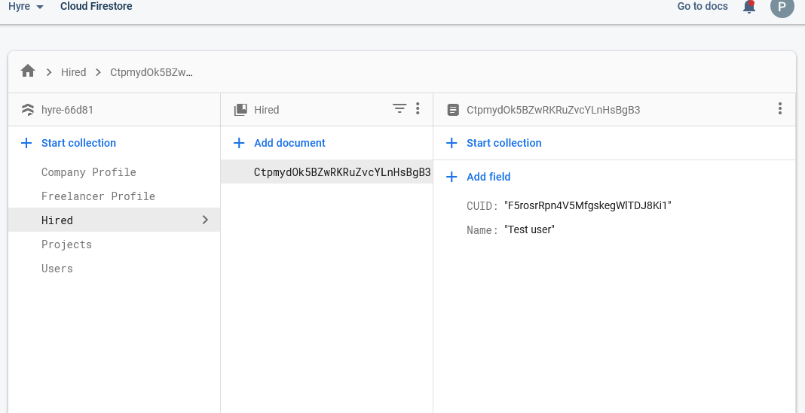
Company Hired Instances

Slide 19
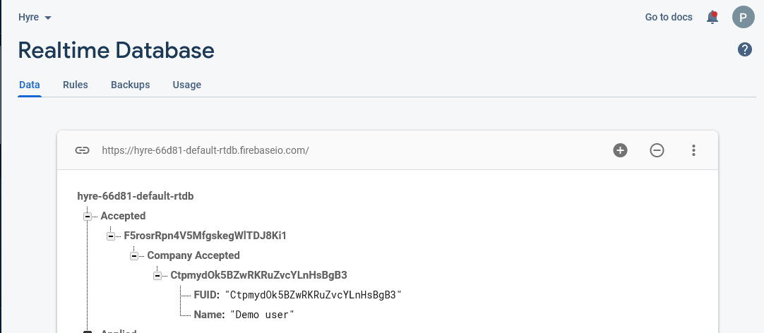
Freelancer connection Instances

Slide 20
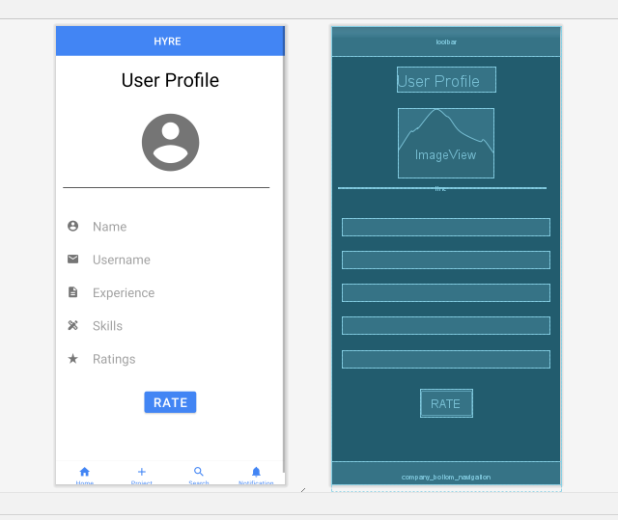
Module 7- Rating

Slide 21
Rating Instances

Slide 22
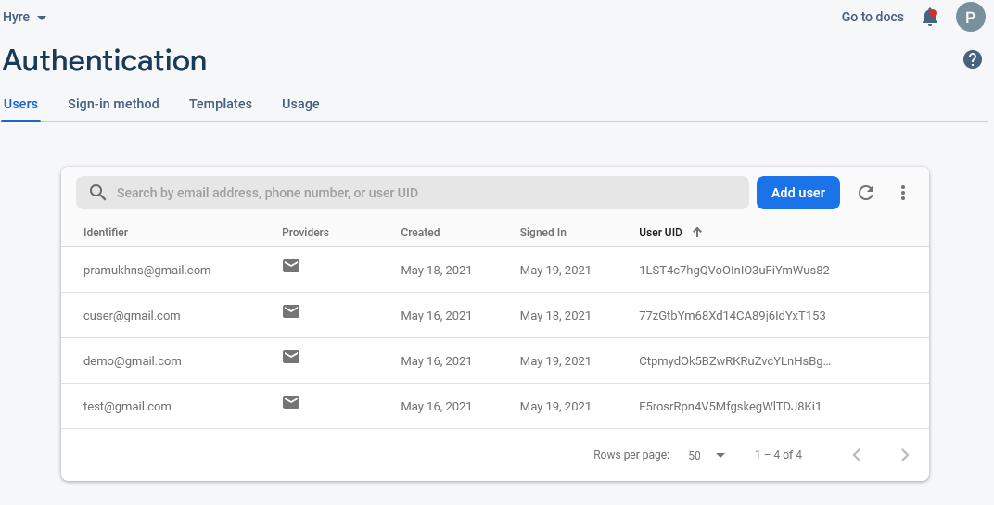
Module 8- Database
Firebase Authentication

Slide 23
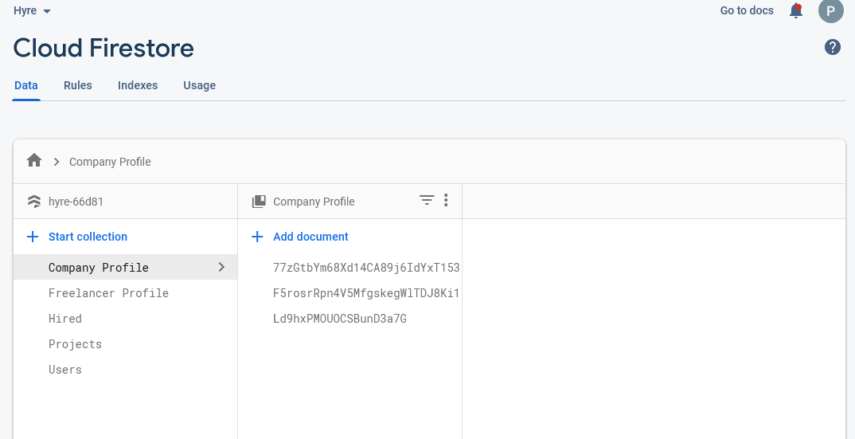
Cloud Firestore

Slide 24
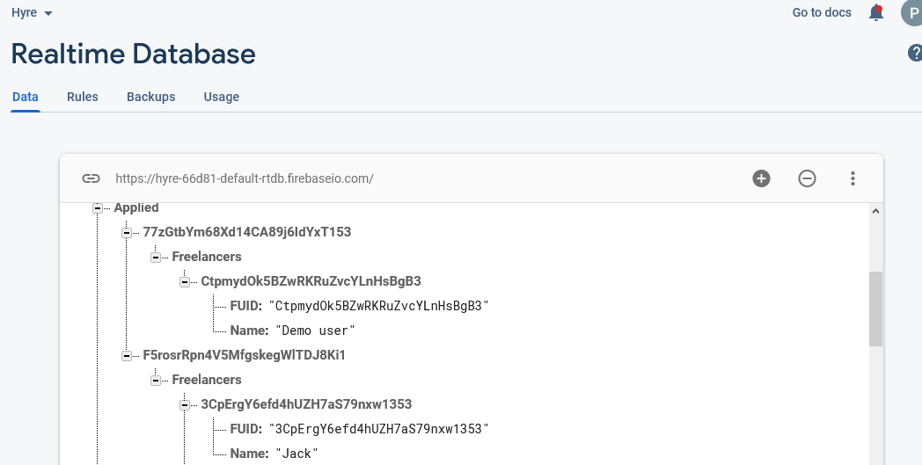
Realtime Database

Slide 25


